Slide 1
Advanced Image Processing
Dr. Rafiqul Islam
Assistant Professor
Department of CSE, DUET

Slide 2
Digital Image processing

Slide 3

Image Transformation
An image Transformation operation typically defines a new image g in terms of an existing image f.
We can transform either the range of f.
Or the domain of f:
What kinds of operations can each perform?
Notes:
Use photoshop to make something grayscale

Slide 4
Image Transformation
Fourier Transform
Wavelet Transform
Radon Transform
Log-polar Transform
How can the operation be performed?

Slide 5
Image Transformation
Algebraic operation

Slide 6
Fourier transform
Is used to decompose the image into sine and cosine components
The results represent the frequency domain information

Slide 7
Fourier Transform
Image analysis
Image filtering
Image reconstruction
Image compression

Slide 8
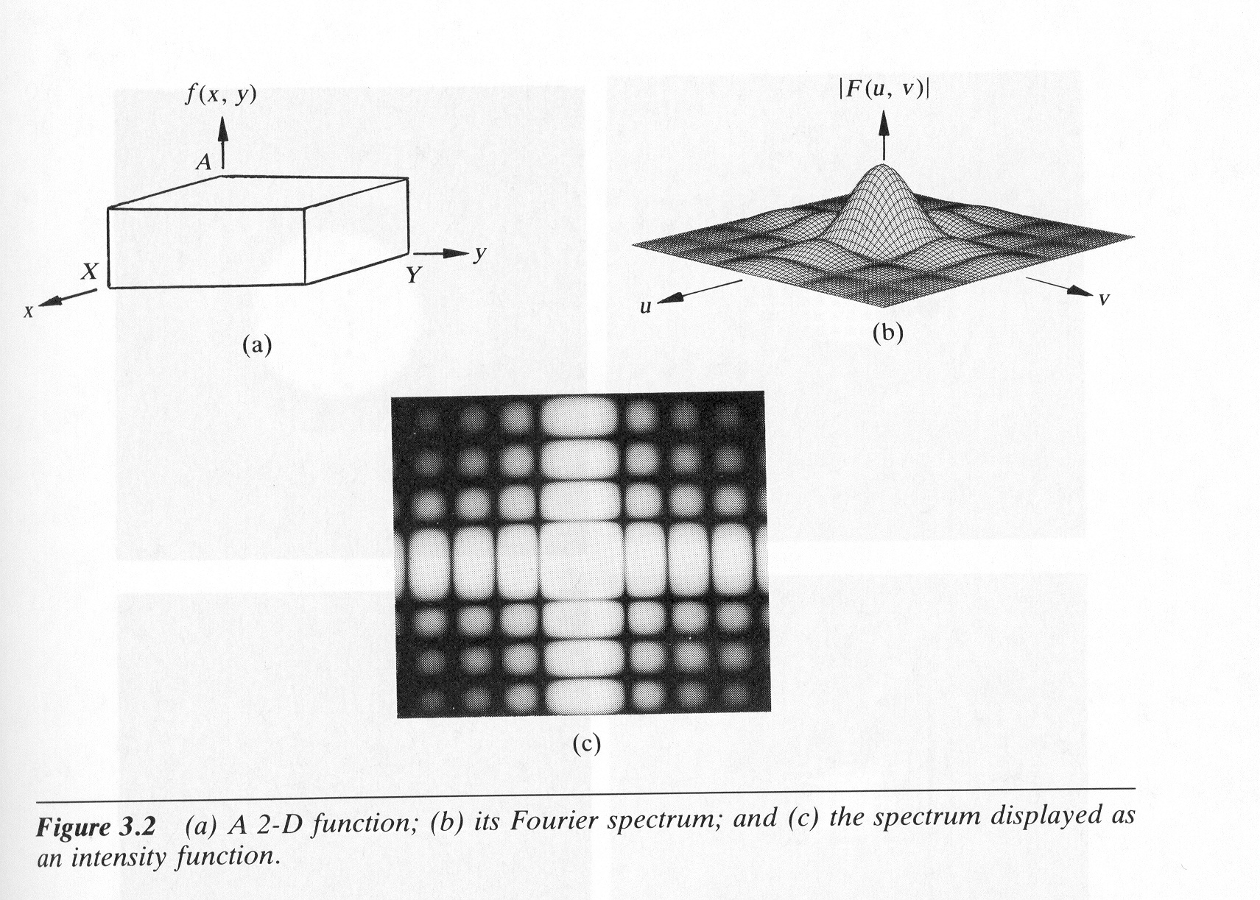
Fourier Transform
Basic Fourier transform is:
f(x)
Fourier
Transform
F(ω)

Slide 9
Fourier Transform – more formally
Represent the signal as an infinite weighted sum of an infinite number of sinusoids
Note:
Arbitrary function
Single Analytic Expression
Spatial Domain (x)
Frequency Domain (u)
(Frequency Spectrum F(u))
Inverse Fourier Transform (IFT)

Slide 10
Fourier Transform
Properties
Linearity
Shift invariance
Convolution
Modulation

Slide 11
Fourier Transform
Also, defined as:
Note:
Inverse Fourier Transform (IFT)

Slide 12
Discrete Fourier transform (DFT)
Is the sampled of Fourier transform
does not contain all frequencies forming an image
but only a set of samples which is large enough to fully describe the spatial domain image.
The number of frequencies corresponds to the number of pixels in the spatial domain image.

Slide 13
Discrete Fourier transform
For a square image of size N×N, the two-dimensional DFT is given by:
where f(a,b) is the image in the spatial domain and the exponential term is the basis function corresponding to each point F(k,l) in the Fourier space

Slide 14
Discrete Fourier transform
The inverse Fourier transform is given by:
Note the 1/N^2 normalization term in the inverse transformation. This normalization is sometimes applied to the forward transform instead of the inverse transform, but it should not be used for both

Slide 15
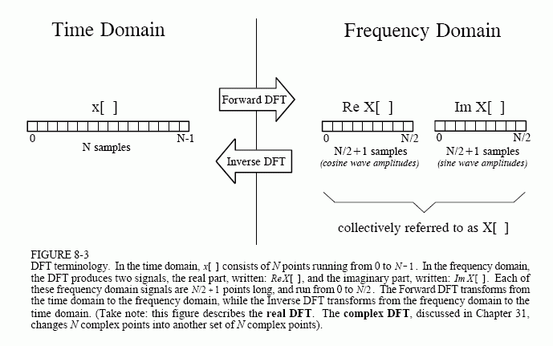
Discrete Fourier Transform

Slide 16
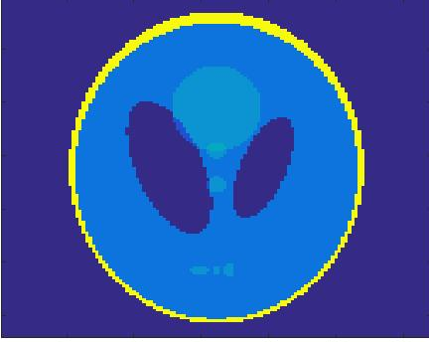
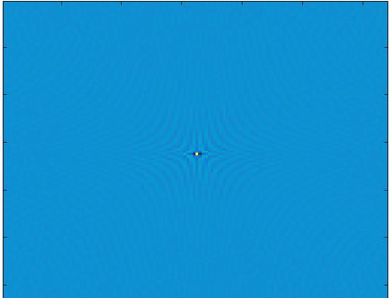
Discrete Fourier Transform
Example
DFT of Main image
(Fourier spectrum)
Main Image (Gray Level)

Slide 17
Discrete Fourier Transform
Matlab Code for DFT
>> a = phantom(128);
>> b = fft2(a);
>> figure(1), imshow(a), colormap(gray)
>> axis off
>> figure(2), imshow(real(b)), colormap(gray)
>> axis off

Slide 18
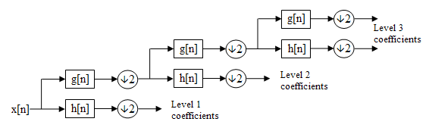
Wavelet Transform
Multi-resolution analysis in frequency domain
Haar
DWT
CWT
An example of 3-level decomposition

Slide 19
Wavelet Transform
The Haar functions are def:ined as

Slide 20
Haar wavelet Transform
Haar transform matrix for sizes N=2,4,8
Can be computed by taking sums and differences.
Fast algorithms by recursively applying Hr_{2.}

Slide 21
Haar wavelet Transform
Haar transform of Main image
Main image

Slide 22
Haar wavelet transform
Matlab Code for Haar wavelet transform
>> load woman;
>> nbcol = size(map,1);
>>[cA1,cH1,cV1,cD1] = dwt2(X,'db1');
>> cod_X = wcodemat(X,nbcol);
>> cod_cA1 = wcodemat(cA1,nbcol);
>> cod_cH1 = wcodemat(cH1,nbcol);
>> cod_cV1 = wcodemat(cV1,nbcol);
>> cod_cD1 = wcodemat(cD1,nbcol);
>> dec2d = [...
cod_cA1, cod_cH1; ...
cod_cV1, cod_cD1 ...
];
>> figure(1), imagesc(X), colormap(gray)
>> figure(2), imagesc(dec2d), colormap(gray)

Slide 23
Radon transform
CT – Computer Tomography
MRI – Magnetic Resonance Imaging
PET – Positron Emission Tomography
SPECT – Single Photon Emission Computer Tomography

Slide 24
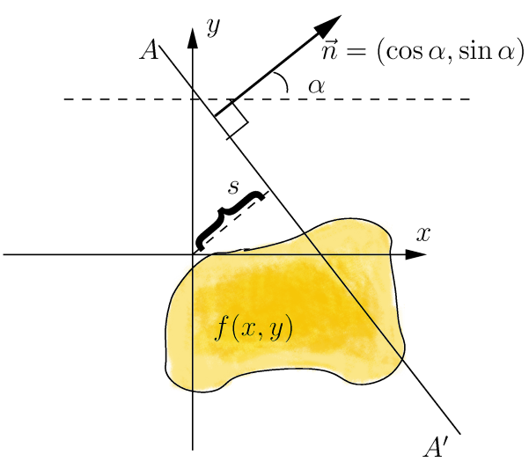
Geometry of 2D Radon transform
Input space coordinates x, y
Input function f(x, y)
Output space coordinates a, s
Output function F(a, s)

Slide 25
Theory of pure RT and IRT
Radon transform
Inverse Radon transform

Slide 26
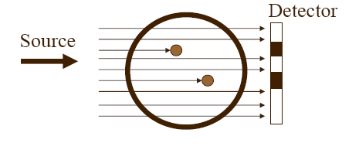
Radon Transform
Example

Slide 27
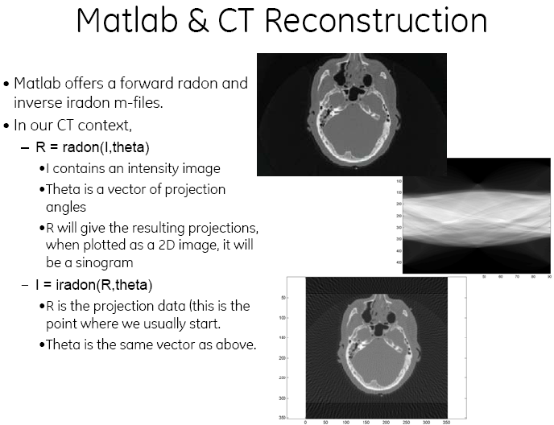
Radon Transform in Matlab
sinogram

Slide 28
Discrete Cosine Transform
DCT is similar to the Fast Fourier Transform (FFT), but can approximate lines well with fewer coefficients
Used in JPEG and MPEG
Another Frequency Transform, with Different Set of Basis Functions

Slide 29
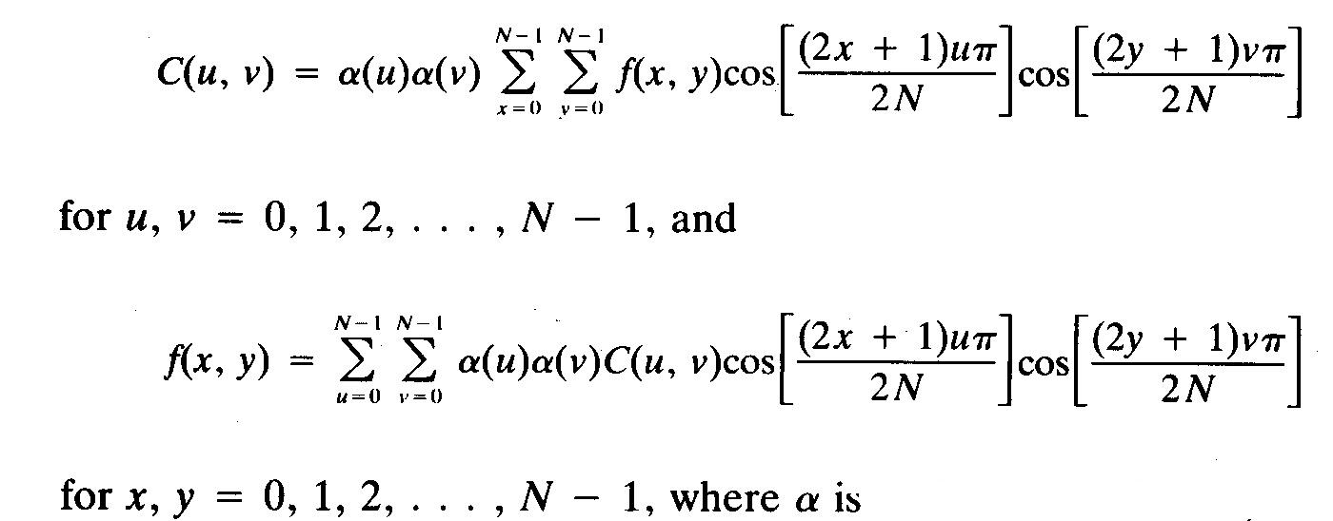
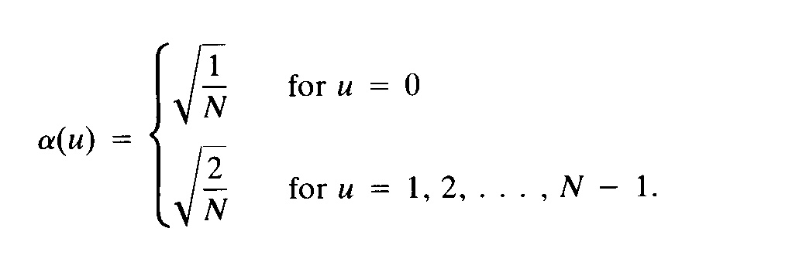
Discrete Cosine Transform

Slide 30
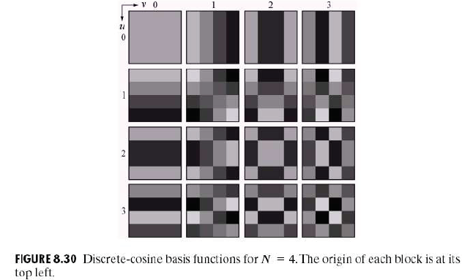
Discrete Cosine Transform
Each block consists of 4×4 elements, corresponding to x and y varying from 0 to 3. The highest value is shown in white. Other values are shown in grays, with darker meaning smaller.

Slide 31
Discrete Cosine Transform
Example
Main Image (Gray Level)
DCT of Main image
(Cosine spectrum)

Slide 32
Discrete cosine transform
Matlab Code for DCT
>> a=imread('cameraman.tif');
>> b = dct2(a);
>> figure(1), imshow(a), colormap(gray)
>> figure(2), imshow(b), colormap(gray)

Slide 33
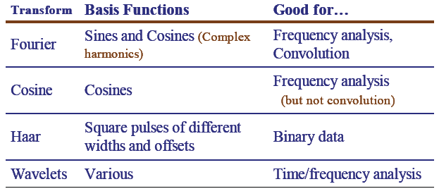
Comparison Of Various Transforms

Slide 34
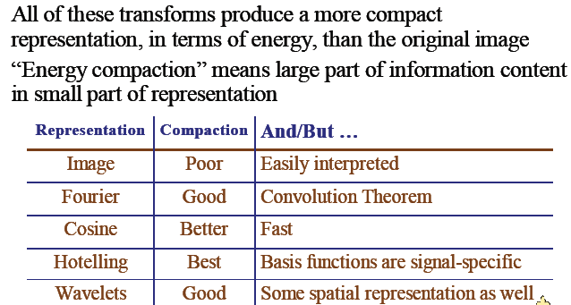
Comparison Of Various Transforms

Slide 35
Image Filtering
Filtering is a technique for modifying or enhancing an image.
For example, you can filter an image to emphasize certain features or remove other features.
Image processing operations implemented with filtering include smoothing, sharpening, and edge enhancement.

Slide 36
Image Filtering- Convolution
Linear filtering of an image is accomplished through an operation called convolution.
Convolution is a neighborhood operation in which each output pixel is the weighted sum of neighboring input pixels.
The matrix of weights is called the convolution kernel, also known as the filter.
A convolution kernel is a correlation kernel that has been rotated 180 degrees.

Slide 37
Image Filtering
The general implementation for filtering an MXN image with a weighted averaging filter of size mxn is given by
where a=(m-1)/2 and b=(n-1)/2

Slide 38
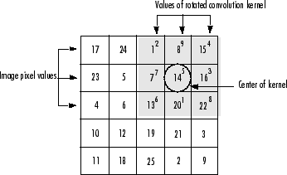
Image Filtering
For example, the image is:
The correlation kernel is:
Hence the (2,4) output pixel is:
1.2+8.9+15.4+7.7+14.5+16.3+20.1+22.8 = 575

Slide 39
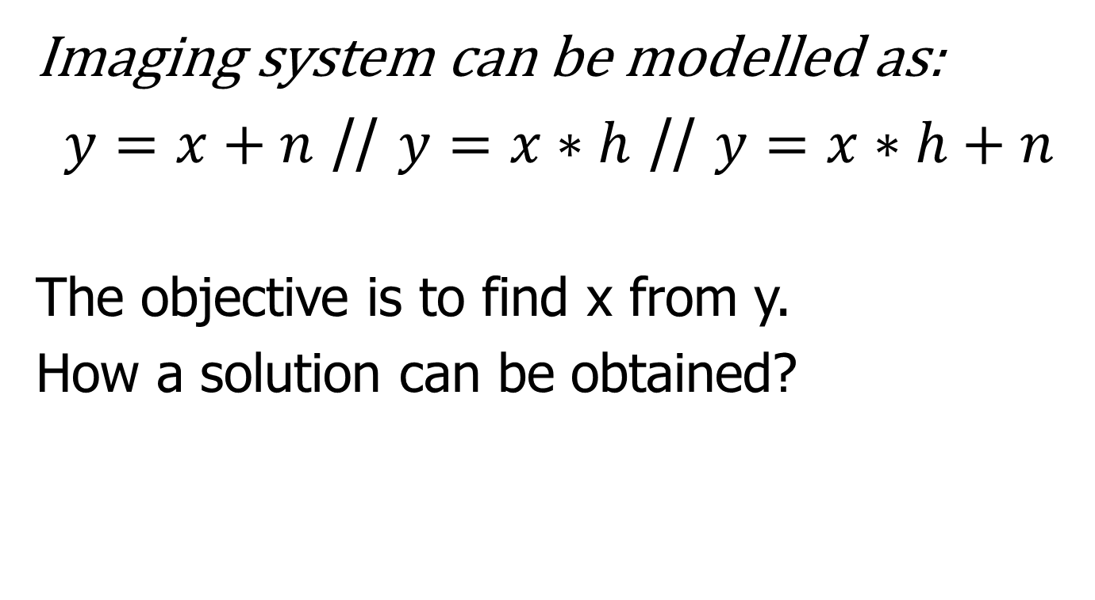
Image Filtering
Imaging system can be modelled as:
$y=x+n$ // $y=x∗h$ // $y=x∗h+n$
The objective is to find x from y.
How a solution can be obtained?

Slide 40
Image Filtering
Mean filters
Median filters
Inverse filtering
Wiener filtering
How the noise can be modelled?

